Slide 1
Route Optimization Solution
Ashirvad Gupta
April 22nd 2017

Slide 2
Objective
To develop an optimal routing solution for Spring Cleaning Services which enables timely and qualitative service for their customers at a reduced cost.

Slide 3



Stakeholders

Slide 4
Data Understanding
Variables:
time taken for service
distance between stops (depots or service stops)
time frame specified by the customers.
Constraints:
minimum and maximum stops per route
maximum route time for a vehicle
minimum and maximum allowable time window.

Slide 5
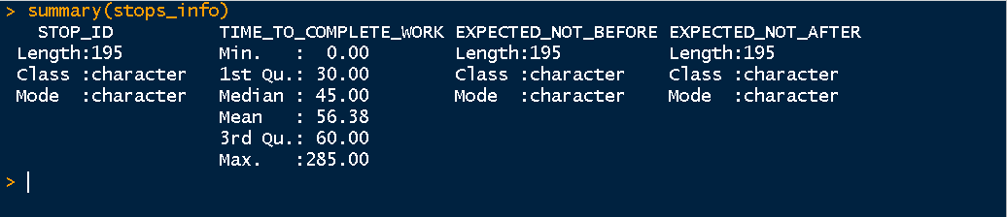
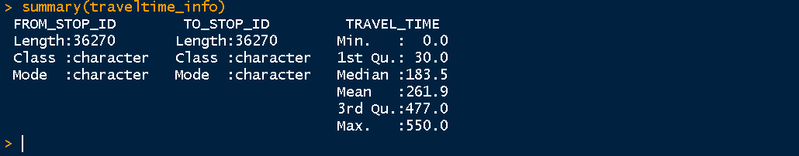
Data Understanding
Observations:
Max Job Service Time – 285 minutes.
Observations:
195 X 195 Travel Time - 38025 Observations needed
36270 observations
Max Travel Time – 550 minutes.
Multiple cities involved.

Slide 6
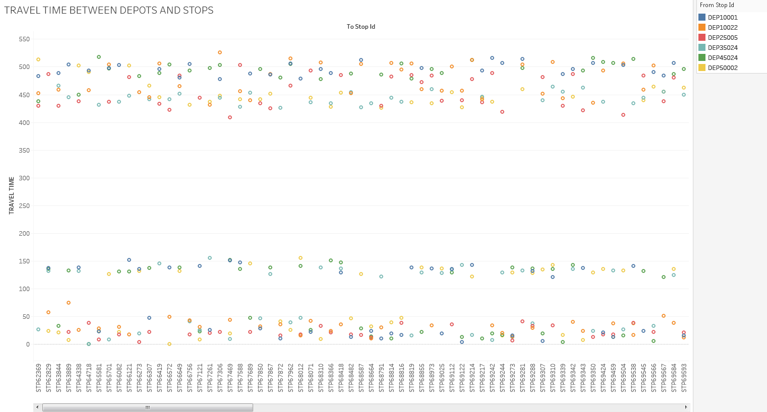

Slide 7
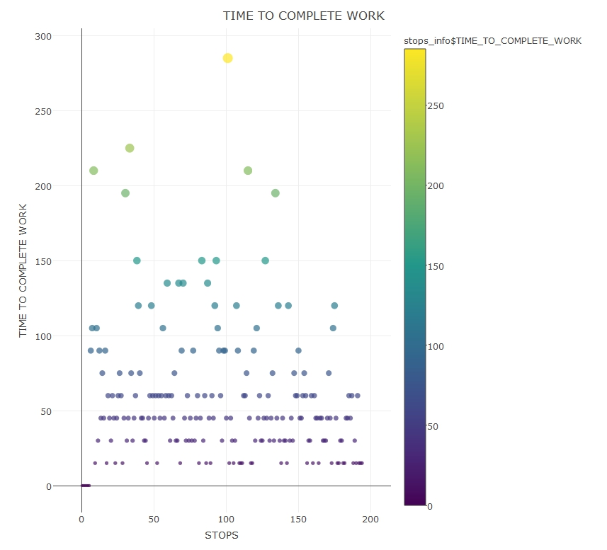

Slide 8
Assumptions
Cost of Vehicles.
Driver charges.
Service Cost.
Penalty Cost.
One cleaner and driver per vehicle for a route.
Same return time if the travel time for return trip is missing.

Slide 9
Data Preprocessing
Missing values are imputed with
Reverse Lookup Approach
Nearest Neighbors Approach

Slide 10
Line of Action
Minimize overall time for Program Execution
Minimize ∑x_{ij} + ∑y_{j} + ∑p
₳ x_{ij} = x_{ji}
where x_{ij} is the travel time from stop i to j
and y_{j} is the job execution time at stop j
and p is the penalty for a route.

Slide 11
Methods Implemented
Depot’s Nearest Neighbors Model (DNN Model)
Genetic Algorithm Model using Randomly Generated Initial Population
Genetic Algorithm Model using DNN Generated Initial Population

Slide 12
Evaluation Metric
Evaluation metric is best fitness values and cost for all the 6 sets of parameters with minimum execution time.
Time taken to generate a solution for a parameter
DNN Model – 2 seconds
GA Model with Random Initial Population- 18 to 30 minutes
GA Model with DNN Initial Population- 4 to 20 minutes.

Slide 13
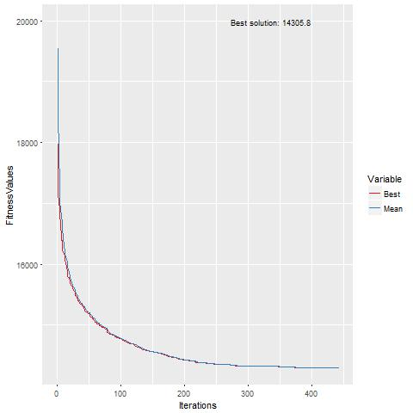
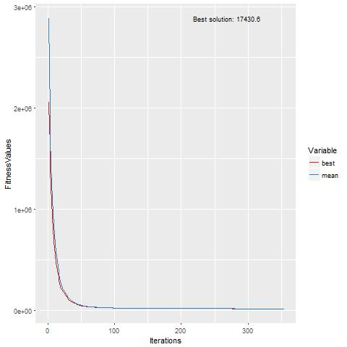
GA Model using DNN
10 minutes and 47 seconds
GA Model using Random
Population
22 minutes and 18 seconds

Slide 14
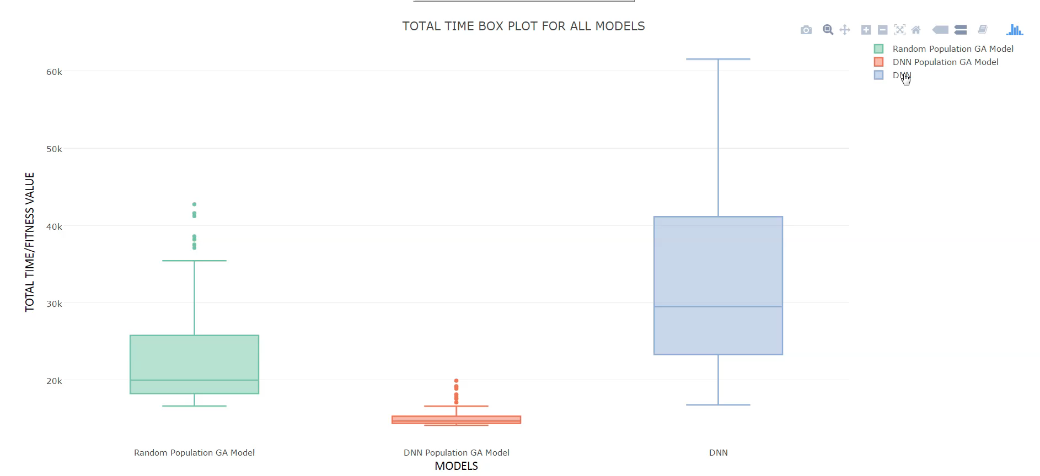

Slide 15
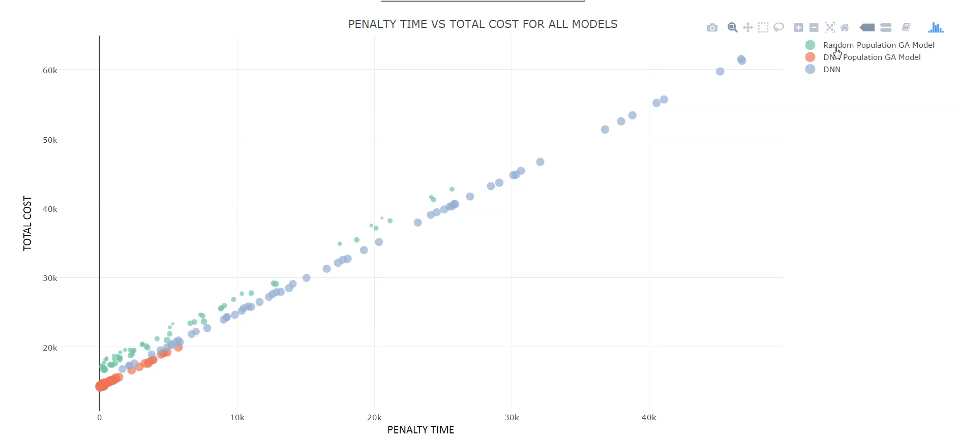

Slide 16
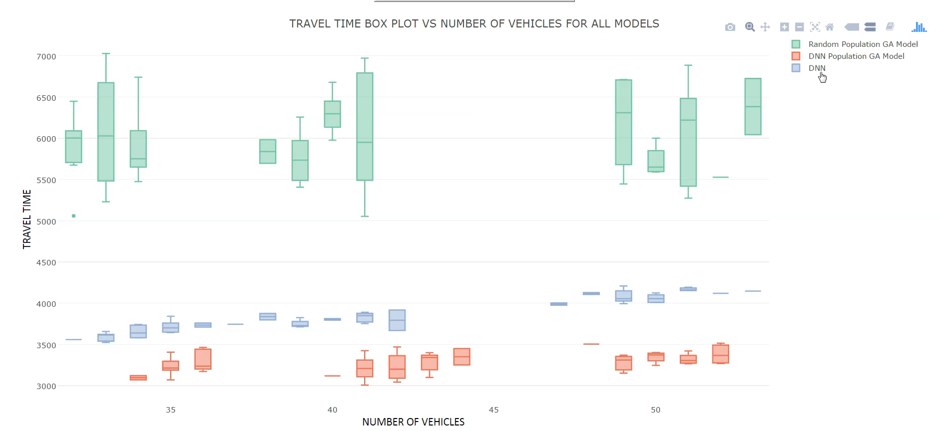

Slide 17
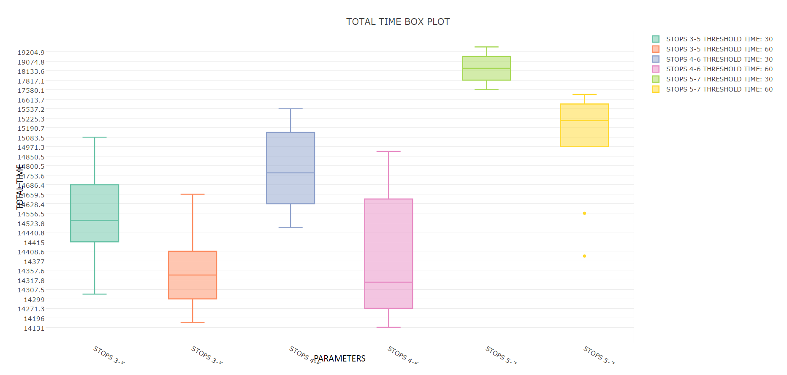
GA Model using DNN Generated Initial Population

Slide 18
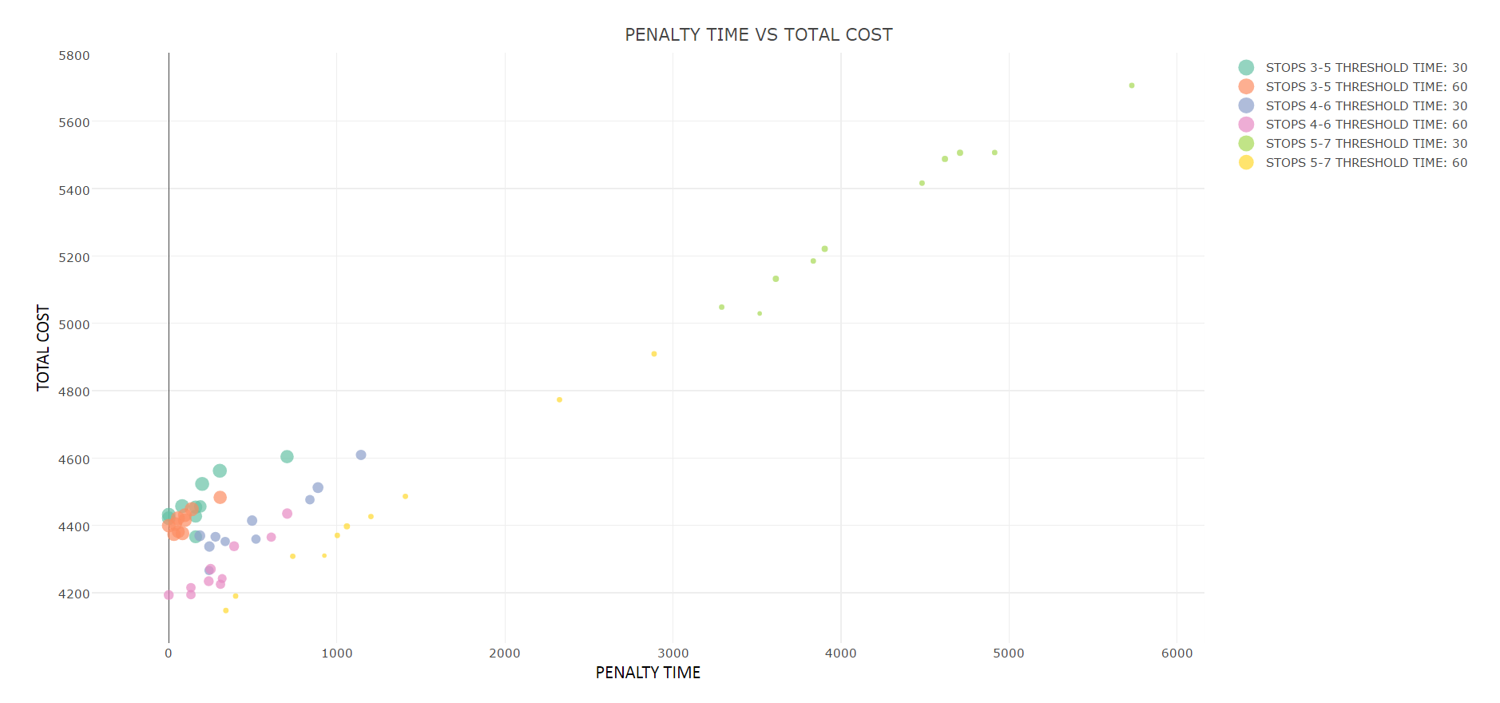

Slide 19
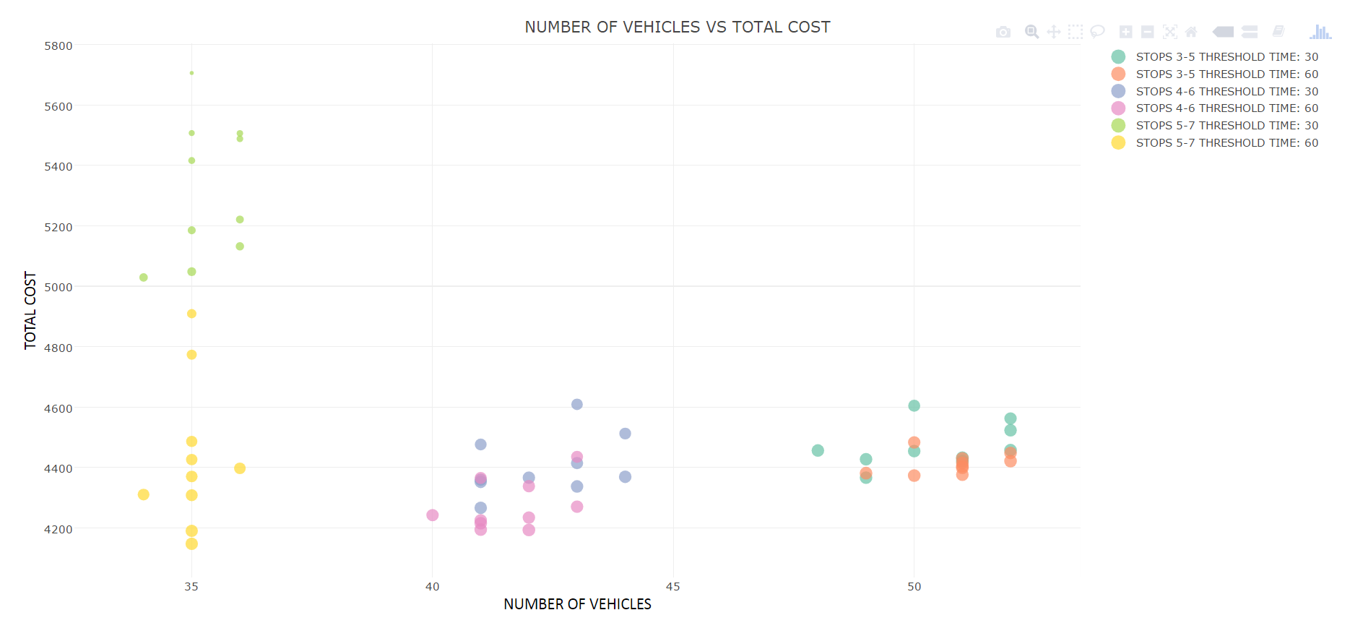

Slide 20
Conclusion
With DNN generated Population in GA model, routes are further optimized for all set of parameters.
Model gives most optimal solution for stops range 4 to 6 with minimum penalty.

Slide 21
Scope of Improvement
Sensitivity Analysis can be done.

Slide 22
Q & A

